Slide 1
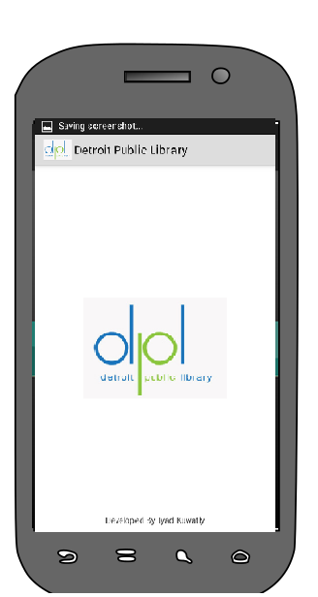

Detroit Public Library App
Iyad Kuwatly – 7/12/2014

Slide 2
Outline
App Features
App Video
Design concepts walkthrough
App Wire Diagram
Brief Technical Design Features

Slide 3
App Features
Easy access to Detroit Public Library information including:
1- Books Search (With barcode scan capability)
2- View book before borrowing it using google books API
3- Featured Books and Collections
4- Library News
5- Library Events
6- My Account
7- Library Locations (with google maps directions)
New unique features

Slide 4
App Features
More features:
1- Customer reminders to return books using push notifications
2- Optional alerts about library exceptional closing hours using push notifications
3- Easy access to library locations using google maps

Slide 5
App Video
Please checked attached video demo

Slide 6
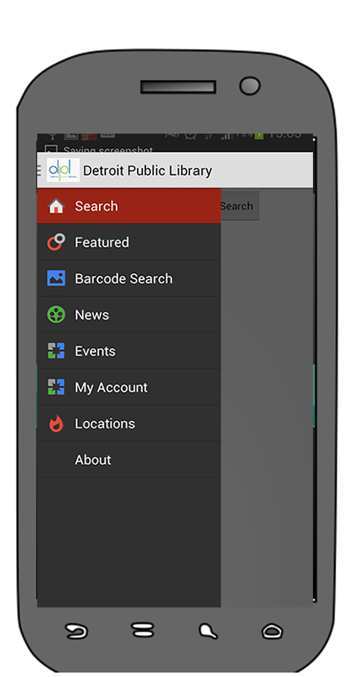
App Home
App Home screen for easy navigation to the rest of the app screens. This includes the following:
Search
Featured
Barcode Search
News
Events
My Account
Locations
About

Slide 7
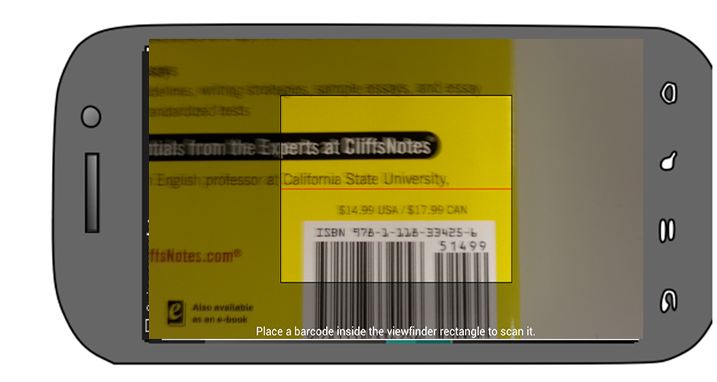
App Barcode Search
Search for a book anywhere with your app
For example: at friend's house, at work or in a book store
Have the chance to instantly place hold till you arrive to DPL to borrow it

Slide 8
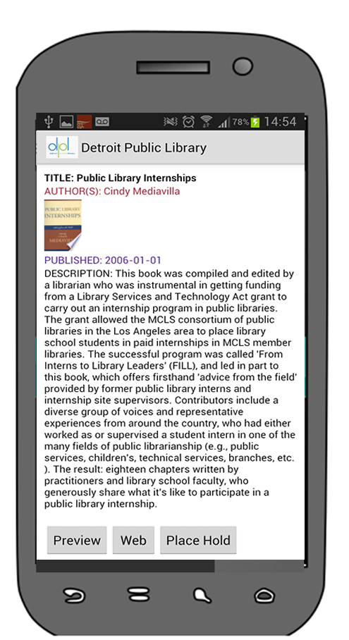
Get more information about a book
Get Book information from google books API
Information includes:
1- Book title
2- Authors
3- Description
4- Cover Image
This page also features:
Place Hold if the book is available for rent

Slide 9
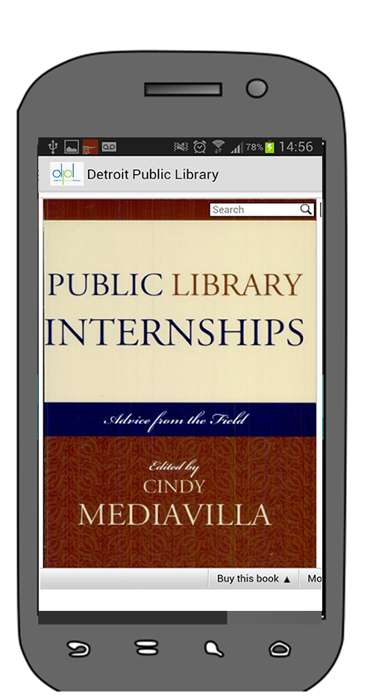
View Book Contents
View book contents using google embedded books API
Before renting the book have a look at the book contents and read some pages

Slide 10
Get more information about a book
Other features not implemented in app yet include:
1- Share the book using your favorite social media including Facebook and twitter so your friends know about the book and its availability in DPL
2- Add the book to favorites in case it is currently not available and get push notifications when it becomes available

Slide 11
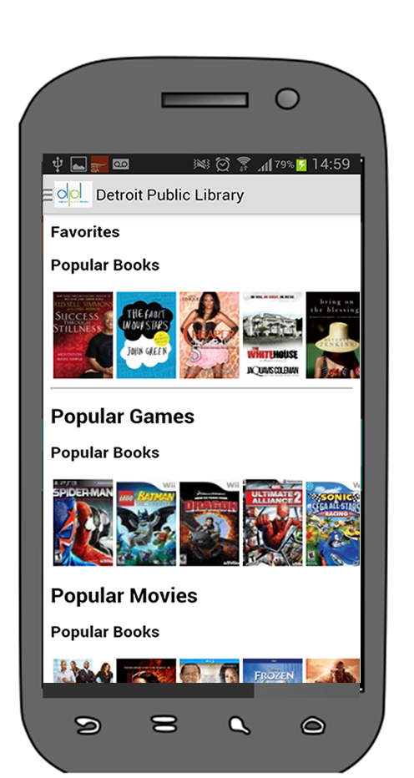
Featured Items
Check the latest library featured items including
1- popular books
2- games
3- movies
4- library unique special collections

Slide 12
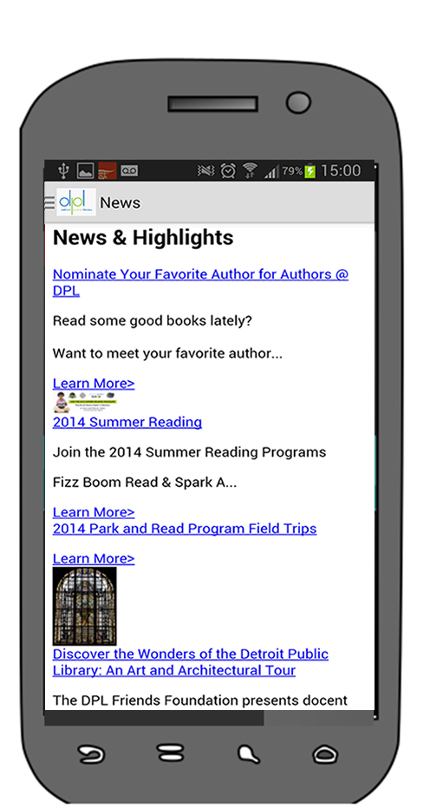
Library News
Check the latest library events

Slide 13
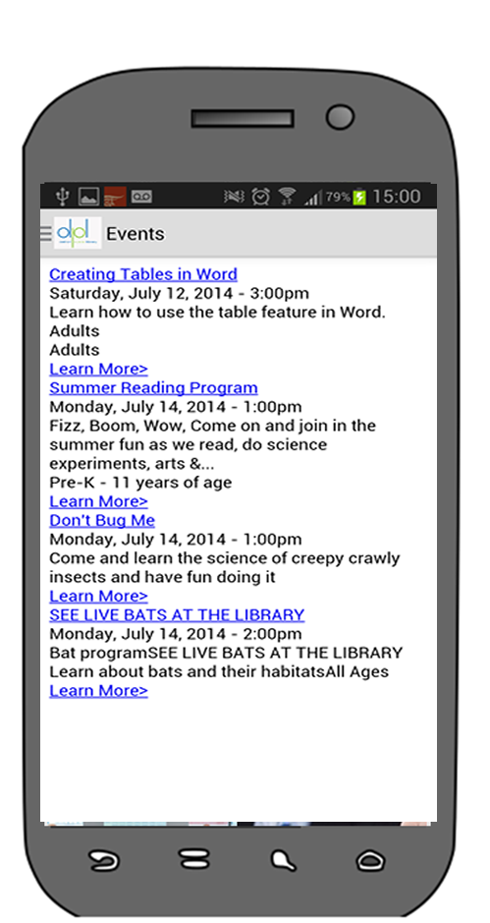
Library Events
Check the latest library events

Slide 14
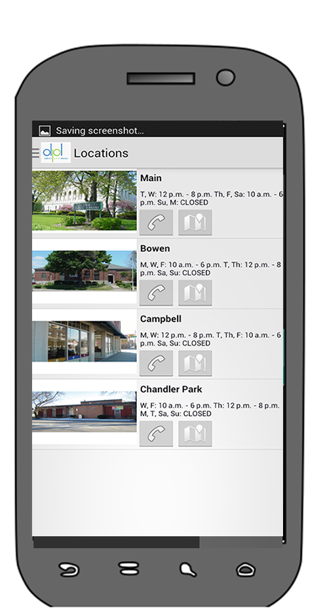
Library Location
Get all library locations
Ability to get directions using google maps
Ability to call location directly from phone

Slide 15
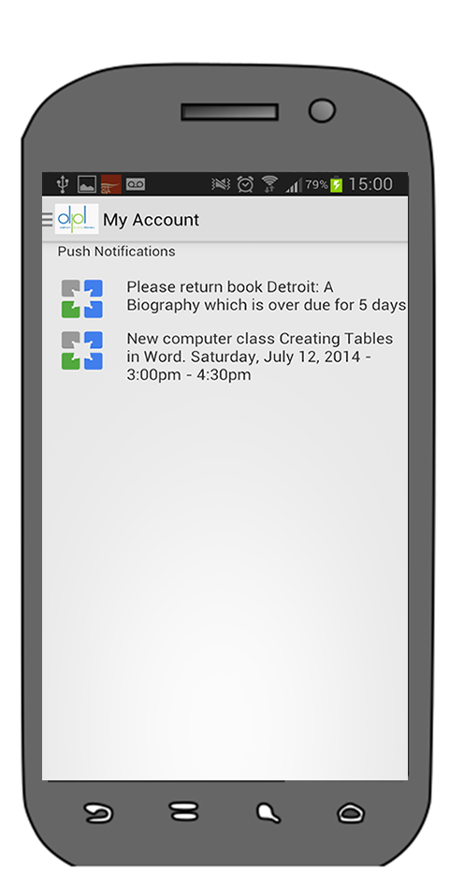
My Account
Login Information
Reminder for returning a book
New books similar to what you borrowed in the past
If the backend supports user data analytics, more features can be delivered here including recommendations and new releases
Information delivered directly to the phone using push notifications depending on user preference
Urgent library shutdown and other library news
Favorites books or events update

Slide 16
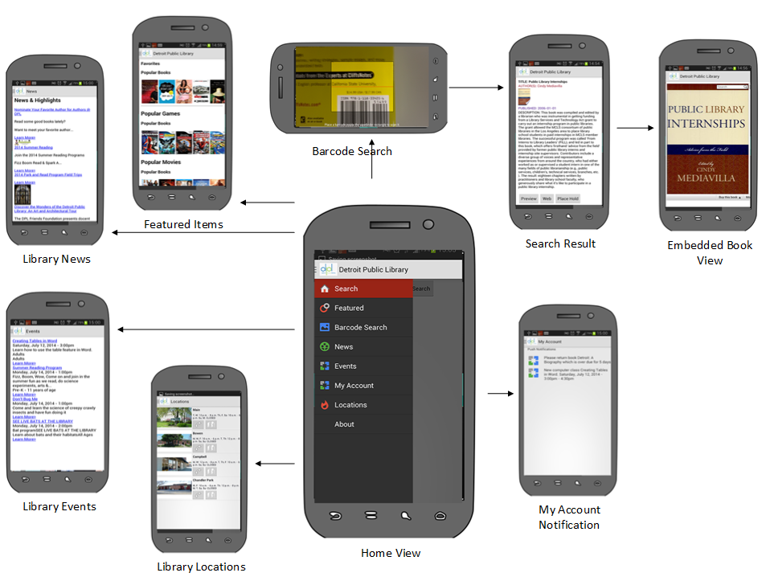

Slide 17
App Technical Features
The app runs on Android OS and was developed using Eclipse and uses the following technical feature to provide its contents:
Http request to Google Books API data using ASYNC task
Google Books Embedded books
Barcode scanning Library using mobile camera
Library Location directions using Google Maps
Special Intents for phone calls to library directly from phone

Slide 18
Thank You!
Special Thanks to
Detroit Public Library
And all sponsors, organizers and participants for making this happen

